Slide 1
INFO 215: Social Aspects of Information Systems Week 2A – Data, Information, & knowledge: IMPACTs ON SOCIETY

Slide 2
Technology Definitions
Some different definitions to consider:
Anything that people have used or made.
Applied scientific knowledge.
Use and knowledge of tools and crafts to control and adapt to an environment.
Material objects of use to humanity, such as machines, hardware or utensils.
Systems, methods of organization, and techniques.
Which definition do you prefer, and why? Or do you prefer a definition that’s not listed here?

Slide 3
Technologies shape social processes - often unpredictably. Social processes shape technologies - often unpredictably. Technologies evolve in complex, unpredictable and nonlinear ways.
social processes
social processes
technological processes

Slide 4
Common Hallmarks of Sociotechnical Studies
Examine technology use in institutional, cultural, and other contexts.
Show that individuals and groups plan and adopt technology in different ways with different outcomes.
Show that technology benefits some groups more than others.
Remember: context is key.

Slide 5
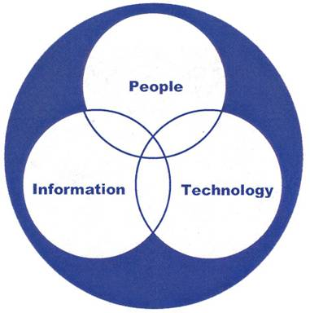
we’ve discussed people & technology, but what about information?

Slide 6
Ackoff (DIKW)
What is/are data?

Slide 7
Ackoff (DIKW)
What is information?

Slide 8
Ackoff (DIKW)
What is the difference between
knowledge and understanding?

Slide 9
Ackoff (DIKW)
What is the difference between
effectiveness and efficiency?

Slide 10
Ackoff (DIKW)
How does wisdom relate to our discussion of Brey last week?

Slide 11


Summary of Key Concepts: Knowledge – Information – Data
knowledge
information
Data 215.895.1930
knowledge: application of data and information
information supports knowledge;
information is organized and integrated data; data with added meaning
data: symbols and representations

Slide 12
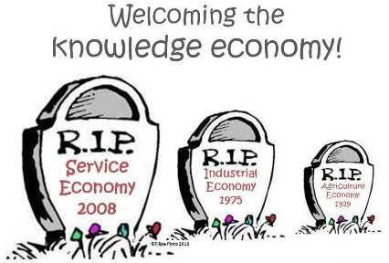
The Information Society
A society integrated by complex communication networks that rapidly develop and exchange information.
A society in which the creation, distribution, diffusion, use, and manipulation of information is a significant economic, political, and cultural activity.
Rather than producing physical “stuff,” the primary products of an information society are information and knowledge.

Slide 13
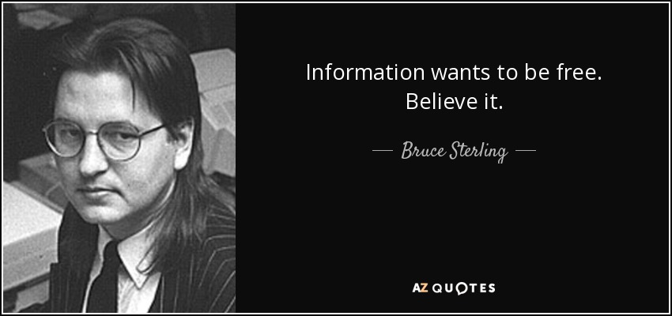

Slide 14
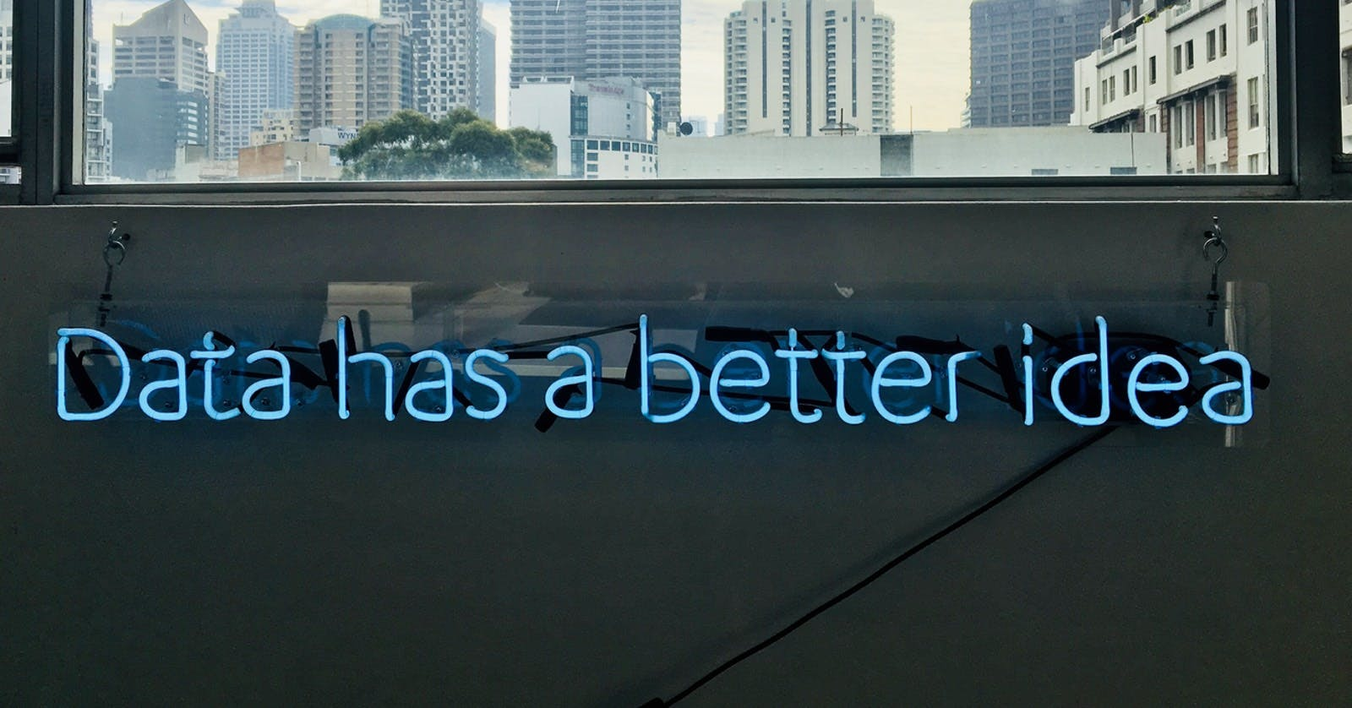

Slide 15
But what do these slogans mean?

Slide 16


Slide 17
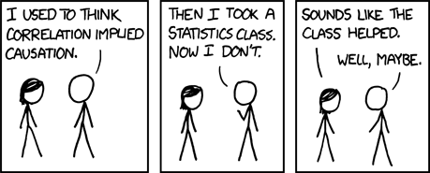
http://xkcd.com/552/
Sociotechnical processes are unpredictable.
Just because B follows A, it does not mean that B is caused by A.

Slide 18
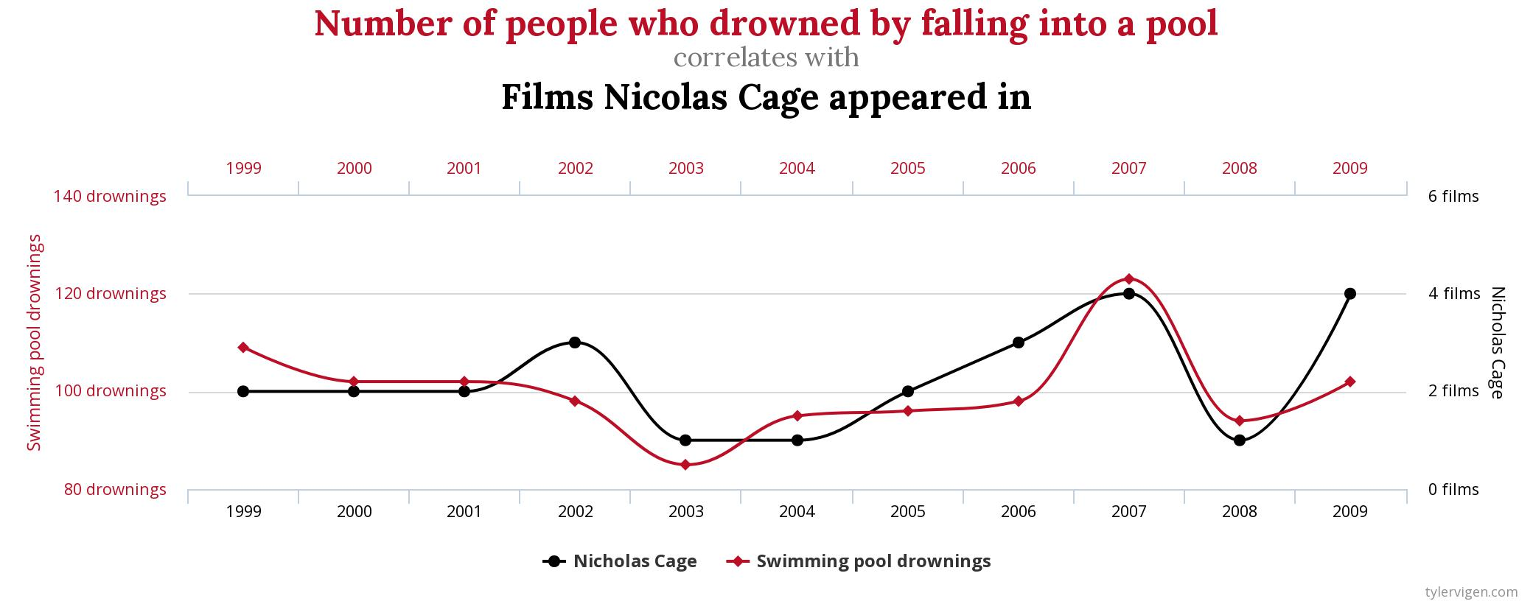

Slide 19
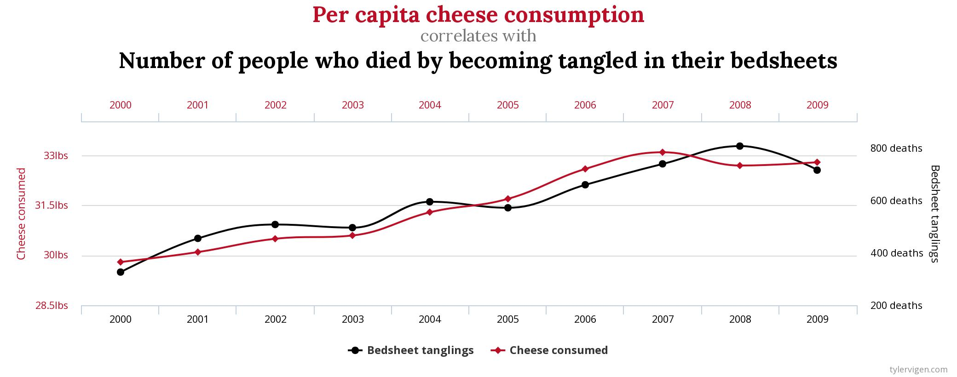

Slide 20
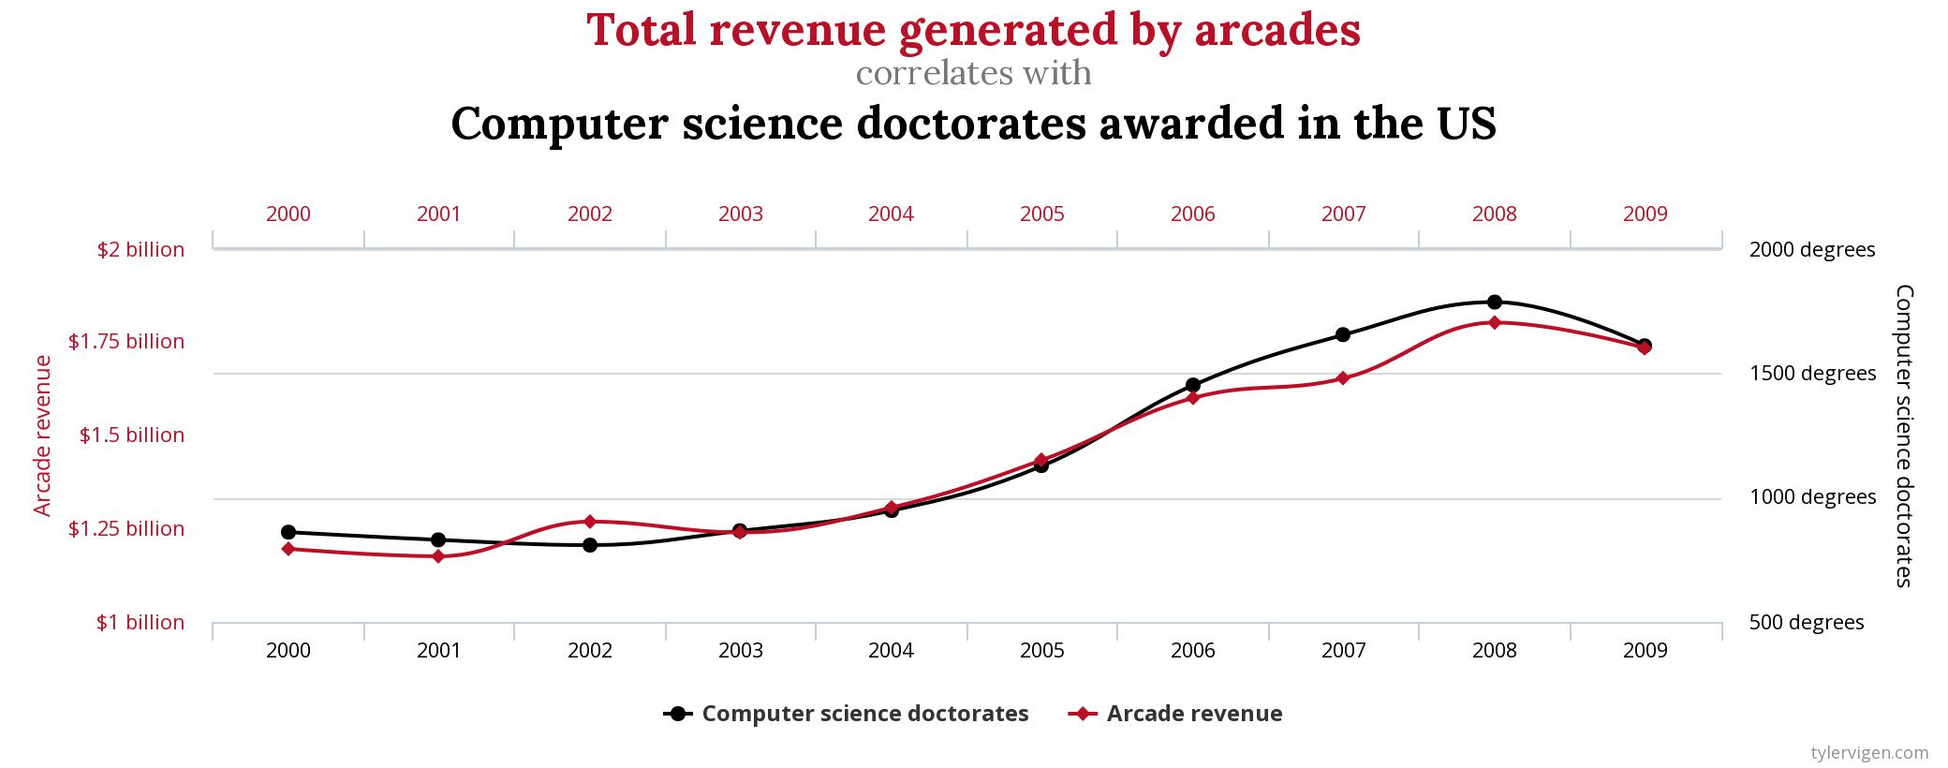

Slide 21
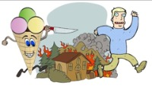
https://www.youtube.com/watch?v=VMUQSMFGBDo

Slide 22
Small Groups
What information systems do you routinely use
to “know” something?
How would you represent the processes that this
information system uses to let you “know”?

Slide 23



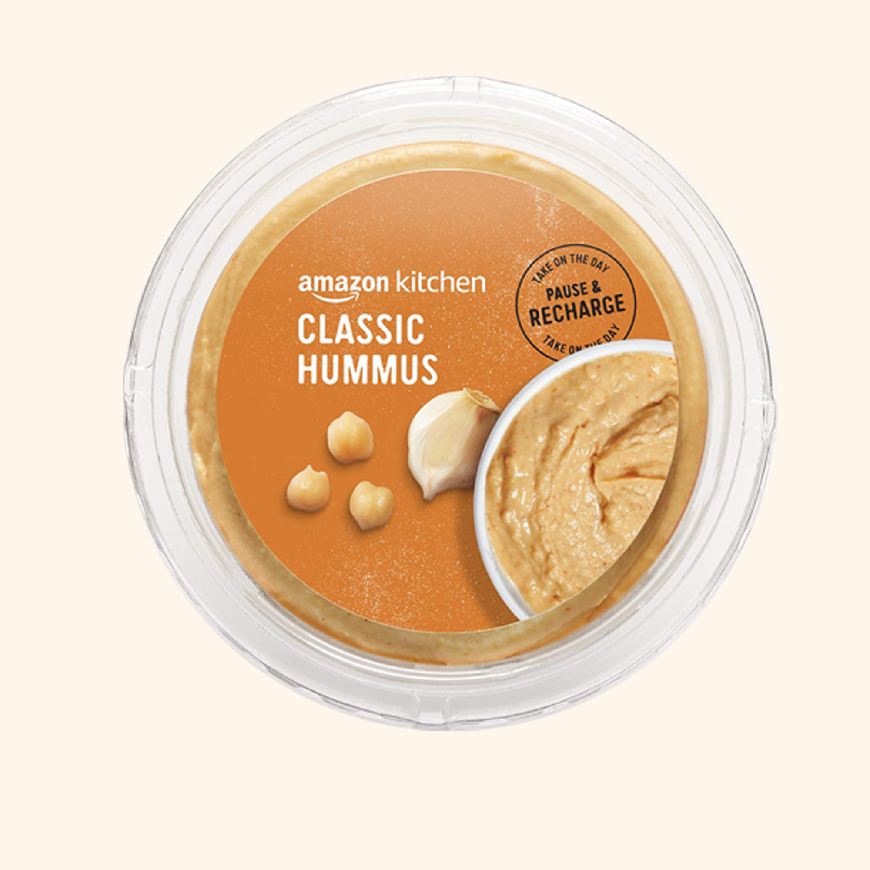

Small Groups
1
3
2
4
5

Slide 24
Small Groups
What is the “raw” data?
How is it used to create information?
What are the limits of the information?
How is the information used?

Slide 25
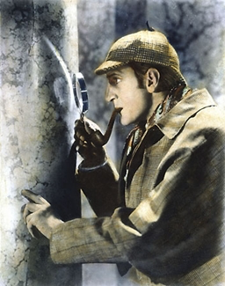

Slide 26
Assignment 1:
Due: Thursday, Oct 13 (Week 4b)
Imagine that you are an intern at Google. You had a strong reaction to their concept video, “The Selfish Ledger,” and you want to communicate your thoughts to your supervisor. You want to do so in order to show them that you deserve a permanent job at Google because you are thoughtful, insightful, and you understand the complex relationship between technology and society at a deep level. So, from the perspective of an intern, write a roughly 500-word email to your supervisor discussing three aspects of “The Selfish Ledger” from a sociotechnical perspective.
Video Link: https://www.youtube.com/watch?v=LUSZfEBTwRc

Slide 27
Assignment 1: (cont’d)
Due: Thursday, Oct 13 (Week 4b)
Your response should:
Be in proper email form, addressed to your supervisor (use my name or make one up);
Include a Subject line;
Include an introductory paragraph that describes what your email is about. This should contain a definition of “sociotechnical” in your own words that uses an example of your own to demonstrate the definition.
Clearly indicate three aspects of “The Selfish Ledger” and describe: (a) why you think they are important; and (b) why you agree or disagree with them from a sociotechnical perspective.
Contain an analysis of each of the three points you’re choosing to discuss (i.e., why you agree/disagree with them).
Analysis of each point should cite at least one scholarly article from the syllabus.
Pro Tip: 100 words per point you analyze is a good goal heuristic.
Contain a summary conclusion that explains why sociotechnical perspectives can improve Google’s vision for “The Selfish Ledger”.
Be about 500 (+/- 50 words) words – it’s an email, after all. (NB: Citations and bibliography do not count toward the 500-word limit ☺)

Slide 28
Assignment 1: (cont’d)
Due: Thursday, Oct 13 (Week 4b)
Format:
Standard formatting and submission requirements apply in addition to those listed below (See syllabus).
Submission must contain all components of a professional email: Subject line; Greeting; Body; Signature; language should be professional, clear, and concise.
Submission should clearly reference the portions of “The Selfish Ledger” you’re responding to. For example, if you’re discussing a point made in the video host made between minutes four and seven, include a timestamp as follows: (00:04:35 – 00:07:50). Your submission should contain such timestamps for each of the three points you’re discussing; if you are discussing specific segments (e.g., “Episodes”) of the video, please make reference to those episode titles.
Please use APA format for references and bibliography (references and bibliography do not count towards the word count)

Slide 29
Assignment 1: (cont’d)
Due: Thursday, Oct 13 (Week 4b)
Grading Rubric:
(4pts) Appropriate format
(4pts) Clarity and organization of writing
(4pts) Definition of “sociotechnical” in your own words + example
(3pts) Specification of the three aspects you agree/disagree with
(6pts) Well-founded agreement/disagreement with the three points you choose
(4pts) Summary of why sociotechnical thinking is required when designing new products/initiatives

Slide 30

https://www.youtube.com/watch?v=LUSZfEBTwRc
https://learn.dcollege.net/bbcswebdav/pid-12169965-dt-content-rid-237904932_1/xid-237904932_1

